Slide 1
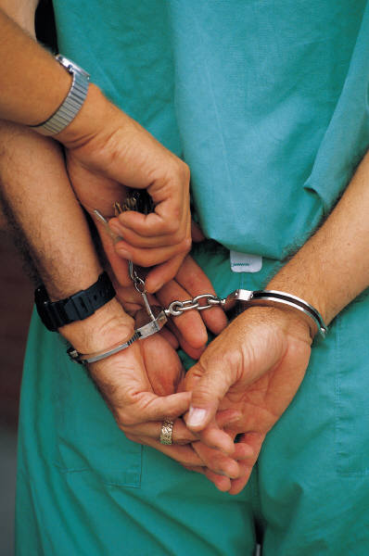
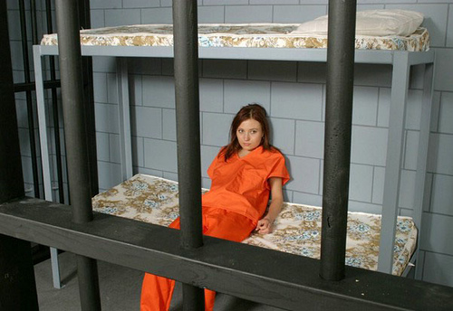

Treatment of Justice Involved Clients with Substance Use Disorders
Igor Koutsenok, MD
Professor of Psychiatry
University of California San Diego, Department of Psychiatry,
Director, Center for Criminality and Addiction Research and Training
Director. International Addiction Technology Transfer Center- Ukraine
Co-Director, South East Asia Addiction Technology Transfer Center

Slide 2
Language is important. This is a reflection of our thinking, training, culture and belief system
I use the term “Justice Involved Clients”
You can call these individuals participants, offenders, defenders, students, clients, etc.
Two things are important:
  Let’s use the least stigmatizing language
  Let’s remember, we are talking about the same people.

Slide 3
Drug Use Severity and Reincarceration
% Reincarceration (15 Months)
Drug Use Severity
N=324; Weekes, Milison, & Lightfoot, http://198.103.98.138/crd/forum/e073/e073c.htm

Slide 4
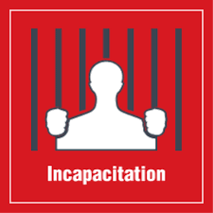
Every prison in the world has incapacitating effect, just the opposite to what we need in addiction treatment

Slide 5
What is the goal of the interventions in this group?
The goal is not just to help them to achieve sobriety, employment, and recovery, but most importantly to protect public safety by reducing criminal recidivism.
Creating “sober criminals” as a result of treatment intervention is NOT a good outcome.

Slide 6
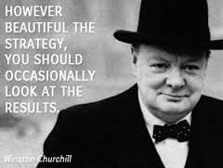
First, let’s review the science

Slide 7
Key issue
We need to appreciate that substance use disorders are chronic and relapsing brain conditions with behavioral expression
This is hard to deny considering the amount of evidence from genetic, neuroimaging and many other studies.

Slide 8
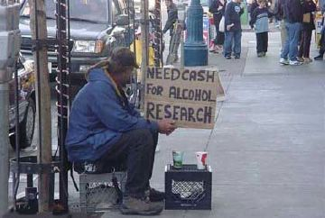
What does the research tell us?

Slide 9
Here is what we know from science
Not a single study of the effects of punishment (custody, mandatory arrests, increased surveillance, etc.) has found consistent evidence of reduced substance relapse rates and criminal recidivism.
Multiple studies indicated that a large number of justice involved clients actually become more criminogenic following incarceration.
Notes:
Here is what we know from high reliability studies. Criminal-justice sanctions alone do not shape pro-social behavior. In fact, some of the low risk offenders (often adolescents) being mixed with high risk offenders during incarceration become high risk offenders (i.e. we make them worse).

Slide 10
You can control behavior to some extent with coercion, and threat of punishment
HOWEVER
Punishment suppress behavior only as long as you have external control, and there will be a predictable rebound when control fades
You better!!!
Or else!!!

Slide 11
Criminal Sanctions Vs. Treatment!
(meta-analysis of 154 studies)
% Reduction in Recidivism
Andrews, D.A. 1994. An Overview of Treatment Effectiveness. Research and Clinical Principles, Department of Psychology, Carleton University. The N refers to the number of studies.

Slide 12
Interventions for Justice Involved Clients
Diversion
Drug Courts
Incarceration
Intermediate
sanctions
Probation

Slide 13

Interventions for Justice Involved Clients
Costs
Diversion
Drug Courts
Incarceration
Intermediate
sanctions
Probation

Slide 14
Interventions for Justice Involved Clients
Public Safety Concerns
Diversion
Drug Courts
Incarceration
Probation w/o verdict
Intermediate
sanctions

Slide 15
What if we put them all in prisons?
Over-reliance
Diversion
Drug Courts
Incarceration
Intermediate
sanctions
Probation

Slide 16
If we rely on prisons only
Criminal Recidivism in 3 Years
68% re-arrested
47% convicted
50% re-incarcerated
Relapse to Drug Abuse in 3 Years
95% relapse

Slide 17
What if we send to all to treatment?
Over-reliance
Diversion
Drug Courts
Incarceration
Intermediate
sanctions
Probation

Slide 18
If we rely on treatment only
Attrition
50% - 67% don’t show for intake
60% - 80% drop out in 3 months
70% drop out within 2 - 6 months
90% drop out in 12 months

Slide 19
Addressing Drugs and Crime Separately
Public Health Approach
-disease
-treatment
Public Safety Approach
-illegal behavior
-punish
High Attrition
High Recidivism

Slide 20
What Doesn’t Work in Criminal Justice Context?

Slide 21
Ineffective Approaches
(no evidence of effectiveness)
Fear-based drug prevention classes
Shaming offenders
Isolated drug education programs
Freudian approaches (psychoanalysis)
Self-Help programs alone
Fostering self-esteem alone
“Punishing smarter” (boot camps, etc.)
Harsh confrontation
“Just Say NO”

Slide 22
So, What Works and How Do We Make It Work?

Slide 23
Four Questions to Ask if We Want to
Provide Effective Interventions
WHOM TO TREAT?
Risk Principle – target higher risk offenders
2. WHAT TO TREAT?
Need Principle – target criminogenic risk/need factors
3. HOW TO TREAT?
Treatment Principle – use behavioral approaches
4. HOW WELL TO TREAT?
Fidelity Principle – implement program as designed

Slide 24
Risk Principle
Risk essentially means a difficult prognosis
Not necessarily a risk for violence or dangerousness
The higher the risk level, the more intensive the supervision and accountability should be; and vice versa
Mixing risk levels is contraindicated
Andrews & Bonta, 2002

Slide 25
Most Common Criminogenic Risks
Criminal onset < 16 years
Prior rehabilitation failures
History of violence
Antisocial Personality Disorder
Familial history of criminal involvement
Criminal associations
Criminogenic thinking and sentiment

Slide 26
Question 2: What to Treat?
Need Principle – target criminogenic need factors
These are needs that are directly linked to criminal behavior.
Any treatment not targeting criminogenic needs is counter-productive to effectiveness.
The most common criminogenic needs – criminal thinking, criminal affiliations and substance use disorders

Slide 27
So, the question is what is the focus of our conversations with Justice involved clients with SUDs in treatment?
What are we talking about?

Slide 28
International Heart Attack Research
Defined risk factors for heart attack
Identified 9 factors in order of importance that predicted 90% of all heart attacks
Cluster 1 predicted 2/3rds

Slide 29
Risk Factors For Heart Attack
CLUSTER 1
Cholesterol
Hypertension
CLUSTER 2
Current smoking
Diabetes
Abdominal obesity
Psychosocial
CLUSTER 3
Failure to eat vegetables and fruits daily
Failure to exercise
No alcohol consumption

Slide 30
Comparison of HA & Crime Risk Factors
Cholesterol
Hypertension
  ________________________
Current smoking
Diabetes
Abdominal obesity
Psychosocial
______________________
Failure to eat fruits & veg
Failure to exercise
No alcohol consumption
Criminal thinking and attitudes
Criminal peers and associations
__________________________
3. Impulsivity
4. Employment
5. Family structure
6. Substance use
__________________________
7. Housing, finances
8. Lower socio-economic status

Slide 31
Risk & Needs Matrix
High Risk
Low Risk
High
Needs
Low
Needs

Slide 32
Risk & Needs Matrix
High Risk
Low Risk
Accountability
&
Treatment
High
Needs
Low
Needs

Slide 33
Risk & Needs Matrix
High Risk
Low Risk
Accountability
&
Treatment
Treatment
High
Needs
Low
Needs

Slide 34
Risk & Needs Matrix
High Risk
Low Risk
Accountability
&
Treatment
Treatment
High
Needs
Low
Needs
Accountability

Slide 35
Risk & Needs Matrix
High Risk
Low Risk
Accountability
&
Treatment
Treatment
High
Needs
Low
Needs
Accountability
Prevention

Slide 36
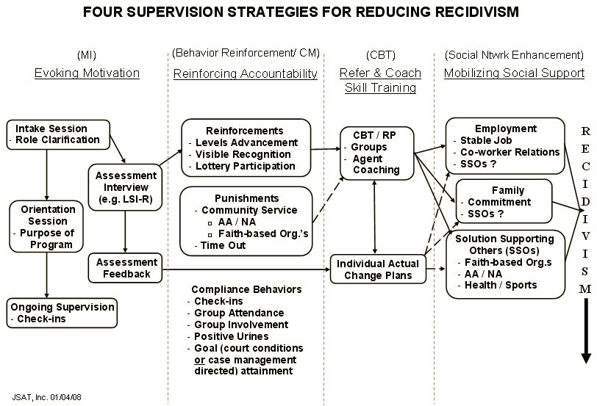

Slide 37
Treatment Should Be Behavioral in Nature
Use rewards and sanctions effectively
Train, practice, rehearse pro-social alternatives with offenders
Completion criteria should be based on acquisition of pro-social skills
Catch them doing something right and reinforce it
Do not delay negative feedback when necessary

Slide 38
Behavioral vs. Non-behavioral
Reduced Recidivism
The N refers to the number of studies.
Andrews, D.A. 2004. An Overview of Treatment Effectiveness. Research and Clinical Principles, Department of Psychology, Carleton University.

Slide 39
Outpatient Drug-Free (ODF) Treatment
Changes from Before to After Treatment
*p<.001
% of DATOS Sample (N=764)
Hubbard, Craddock, Flynn, Anderson, & Etheridge, 2007, PAB

Slide 40
Long-Term Residential (LTR) Treatment
Changes from Before to After Treatment
*p<.001
% of DATOS Sample (N=676)
Hubbard, Craddock, Flynn, Anderson, & Etheridge, 2007, PAB

Slide 41
Texas/New Offenses Only:
3-Year Return-to-Custody Rates (%)
Knight, Simpson, & Hiller, 2009, The Prison Journal

Slide 42
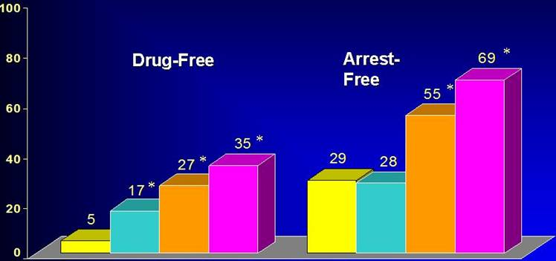


Continuity of care is essential
Delaware Work Release Therapeutic Community (CREST) + Aftercare
3 Years After Release (N=448)
p < 0.05,
compared to No Treatment group
Drug-Free
Arrest-Free
Percentage of Participants
No treatment
No treatment
CREST Dropouts
CREST Completers
+ Aftercare
CREST Dropouts
CREST Completers
+ Aftercare
CREST Completers
CREST Completers
Notes:
Drug abuse treatment works and brings about reductions not just in drug abuse, but also in criminal recidivism. A therapeutic community approach (CREST) was tested in prison, followed by aftercare during the transition back to the community. Among those who completed treatment and aftercare, 35% remained drug free, and 69% had not been arrested in the three years since release. These reductions in turn yield significant cost savings and provide hope for families and communities devastated by addiction.

Slide 43



Pre-Incarceration
“Old Environment”
Incarceration
“Artificial Environment”
Post-Incarceration
“New Environment”
Behavioral Interventions
Re-Integration with Family/Supports
Vocational Training/Education
MAT
Medical Care
Psychiatric Care
Drug Treatment Needs
02:12:03
Basic Needs (food, shelter, safety)
Time →

Slide 44
Treatment Integrity
Provide treatment as it was intended to be provided

Slide 45
Many Pieces to the Puzzle
Medical/
Developmental
Financial
Mental Health
Group
Counseling
Housing &
Transportation
Core
Treatment
Vocational
Urine Monitoring
Individual
Counseling
Intake
Assessment
Case Management
Child Care
Pharmaco-therapy
Educational
Treatment
Plans
Continuing Care
Self-Help
(AA/NA)
Family
Legal/
Crime
AIDS / HIV Risks
Etheridge, Hubbard, Anderson, Craddock, & Flynn, 2007 (PAB)

