Slide 1
Introduction to Adolescent Substance Use
Introduction to Adolescent Substance Use
Notes:
The trainer should welcome all the participants and thank them for being part of this training. S/he should introduce him/herself, adding information to the introduction which provides foundation for his/her expertise in working with adolescents. The trainer should then ask participants to introduce themselves, each saying their name, country of origin/country of work, institution and position there, populations with which they have worked and years experience with adolescents.
The trainer should lead the group to a discussion of basic rules during the time of the training. An easel pad should be used to write these rules. The trainer can start by suggesting an example such as; 1) Respectful listening and communication during discussions. The trainer should allow some participants to suggest other rules to engage them in the process. The trainer can also write one expectation of the current training. S/he should note expectation responses on the easel pad, then review them, pointing out the expectations that will be covered by the training, and those that will not. S/he should thank the participants and point out the different areas of expertise in the room.
The trainer should introduce the training by asking the participants why they think it is important to look at adolescent substance use differently from how we look at adult substance use. What are the most important differences? The trainer should note the responses on newsprint, then validate the reasons that are most noteworthy.
Module 1: Provides an introduction and conceptualization of the topic of adolescent substance abuse.

Slide 2
INTRODUCTION TO ADOLESCENT SUBSTANCE USE
Methodology:
Active discussion
Required Materials:
Easel Pad
Participant Manual
Notepad for each participant
Pens & Pencils
Duration: 4 hours
Notes:
The trainer will point out the methodology for this training. Active discussion refers to the trainer’s lecture but also participation from the audience in the form of questions, comments, suggestions that will enhance mutual learning.
The required materials for this module provide preparation for exercises.
The expected duration of this module is four hours.

Slide 3
INTRODUCTION TO ADOLESCENT SUSBTANCE USE
Learning Objectives:
To prioritize adolescent substance abuse as a global public health problem.
To understand the issue of adolescent substance use and its impact to societies.
To learn about the prevalence of different types of substances adolescents are exposed to across the globe.
To understand the differences between use, misuse and abuse of substances among adolescents.
To learn about the factors that impact future adolescent substance use.
Notes:
The trainer should discuss the learning objectives and engage the group in their comments and whether these objectives have met some of their expectations. The trained should emphasize the need for this type of training. The trainer should ask the group to thoroughly consider participation as they have had experiences working with youth and their experiences are valuable for mutual learning.
Learning Objectives:
To prioritize adolescent substance abuse as a global public health problem.
To understand the issue of adolescent substance use and its impact to societies.
To learn about the prevalence of different types of substances adolescents are exposed to across the globe.
To understand the differences between use, misuse and abuse of substances among adolescents.
To learn about the factors that impact future adolescent substance use.

Slide 4
ADOLESCENT SUSBTANCE USE AS A PUBLIC HEALTH CRISIS
Adolescent substance use is a global public health problem. The harmful use of alcohol causes disease, social and economic burdens in societies.
Drug use and health consequences is highest among young people.
Early use of substances increases a person’s chances of developing an addiction. Drugs change brains—and this can lead to serious neurological damage, drug misuse and other serious problems.
(PLNDP, 2001, UNODC, 2018; WHO, 2001, WHO, 2014)
Notes:
The trainer should be familiar with the description of the problem below and be able to use the bullet points to guide the conversation. The trainer will now conceptualize substance abuse among adolescents as a public health problem.
The problem
Early use of substances increases a person’s chances of developing an addiction. Drugs change brains—and this can lead to serious brain damage, drug misuse and other serious problems. Risk of drug misuse increases greatly during times of transition. Adults and children are affected differently. For an adult, a divorce or loss of a job may lead to drug misuse; for an adolescent, risky times include moving, changing schools and other major transitions. In early adolescence, when children advance from elementary through middle school, they face new and challenging social and academic situations. Often during this period, children are exposed to illicit substances such as cigarettes and alcohol for the first time. When they enter high school, adolescents may encounter greater availability of drugs, drug use by older teens, and social activities where drugs are used.
Adolescent behaviors that are a normal aspect of development, such as the desire to try new things or take greater risks, may increase adolescent tendencies to experiment with drugs. Some teens may give in to the urging of drug-using friends to share the experience with them. Others may think that taking drugs (such as steroids) will improve their appearance or their athletic performance or that taking substances such as alcohol or marijuana will help their anxiety in social situations. Adolescents are still developing judgment and decision-making skills may limit their ability to accurately assess the risks of all of these forms of drug use.
Using illicit substances in adolescence can disrupt brain function in areas critical to motivation, memory, learning, judgment, and behavior control. Therefore, it is not surprising that adolescents who regularly use alcohol and other drugs often have family and social problems, poor academic performance, health-related problems (including mental health), and involvement with the juvenile justice system.
Due to the complex nature of the relationships among all of these areas impacting adolescents, experts came together to address the need for drug misuse services developed specifically for adolescents. These areas of impact are different than those of adults, as is the related brain chemistry. As such, a clear need to develop resources to meet the growing demand for services geared particularly to this target population was identified. This manual is the result of those efforts.
The overall goal of this training series is to reduce the significant health, social, and economic problems associated with adolescent alcohol and other drug use. The goal is to build international treatment capacity through training, professionalizing, and expanding the regional treatment workforce. The training prepares counselors by providing the latest information about adolescents, substance misuse. Facilitators learn information on treatment and how to facilitate hands-on activities to develop skills and confidence in a relatively new treatment workforce. The curricula also provide an updated review for those who are beginning to supervise workers who are new to work with this population.

Slide 5
ADOLESCENT SUSBTANCE USE AS A PUBLIC HEALTH CRISIS
Often during adolescence there, is exposure to substances such as cigarettes and alcohol for the first time.
The goal is to build international treatment capacity through; psychoeducation, counseling, training, professionalizing, and expanding the regional treatment workforce
(PLNDP, 2001, UNODC, 2018; WHO, 2001, WHO, 2014)
Notes:
The trainer emphasizes that adolescent substance use is a public health crisis that must be addressed as this debilitates societies. More specifically, interventions with adolescents are crucial because:
Often during adolescence there, is exposure to substances such as cigarettes and alcohol for the first time.
The goal is to build international treatment capacity through training, professionalizing, and expanding the regional treatment workforce.

Slide 6
INTERNATIONAL STANDARDS
The United Nations’ International Standards on Drug Use Prevention state that adolescents should avoid and abstain from substances to encourage health development and benefit societies.
(UNODC, 2015)
Notes:
The trainer will briefly discuss the international standards on adolescent substance use.
The United Nations’ International Standards on Drug Use Prevention state that adolescents should avoid and abstain from substances to encourage health development and benefit societies. This document provides recent research and interventions of how to address substance abuse in adolescents.

Slide 7
Complete the sentences…
Adolescents today are...
Adolescents today should ..
When I was an adolescent, I felt...
When I was an adolescent, I wanted...
Notes:
The trainer should ask the participants to complete the following sentences through a brainstorm exercise. The trainer will note responses on the Easel pad. After everyone has responded, s/he should read the following quotes, asking the group to identify when in time they believe the quote was originally said.
“I see no hope for the future of our people if they are dependent on frivolous youth of today, for certainly all youth are reckless beyond words…When I was young, we were taught to be discreet and respectful of elders, but the present youth are exceedingly disrespectful and impatient of restraint.”
Hesiod, 8th Century BC
“Our youth now love luxury. They have bad manners, contempt for authority; they show disrespect for their elders and love chatter in place of exercise; they no longer rise when elders enter the room; they contradict their parents, chatter before company; gobble up their food and tyrannize their teachers.”
-Socrates, 5th Century BC
The trainer should point out that adolescence today is not all that different from adolescence throughout time, and that adults have always tended to see adolescents in the same light.

Slide 8
What are my values on Adolescent AOD Use?
Identifying personal values regarding adolescent alcohol and other drug (AOD) use is important for effective communication about these issues with your clients/
Notes:
The trainer will explain that, key to the work that is performed with adolescents, is the understanding of the values and belief system we bring into our work. S/he should ask the group why they believe that their own beliefs would impact work with adolescents. The trainer should lookout for responses such as: bias in development of treatment plans, preconceived notions about clients which can be barriers to a thorough assessment, the adolescent can perceive these beliefs, etc.
The trainer will then explain that the next exercise is to focus on clarifying our own values. S/he should explain that, as far as values are concerned, there are no “right” or “wrong” answers, and that everyone should challenge themselves to be honest regarding their beliefs and responses. The trainer will explain that the next exercise is called “forced choices” and will require that everyone “take a stand” regarding their own reactions to the statements read.

Slide 9
Forced Choices Exercise
Notes:
The trainer will read a variety of statements in connection to adolescents and adolescent AOD use.
Forced Choices Exercise Instructions:
Participants will choose to either agree or disagree with the statements below. This will help participants identify some of their values regarding their personal views. The trainer can ask the group to either move to one extreme of the room if they agree with the statement read, or to the other side of the room if they disagree with the statement read. Alternately, the trainer can ask participants to stand up if they agree with the statement read or remain seated if they disagree with the statement read.
The trainer should read each statement and allow participants to indicate if they agree with the statement or disagree with the statement. Once they have indicated their choice, the trainer should ask those who agreed with the statement why they believe that someone might disagree with the statement. Then, s/he should ask those who disagreed with the statement why they believe that someone might agree with the statement. The trainer should allow some time for discussion.
The trainer should then read each of the following statements, allowing participants to respond and to defend why someone might respond opposite to their own beliefs.
STATEMENTS:
I think that alcohol and other drug use is a normal developmental process.
I am comfortable if an adolescent tells me s/he likes AOD use.
It is acceptable for a seventeen-year-old to drink alcohol.
It is the family’s job to address any adolescent alcohol or drug use.
It’s to be expected that a young person experiments with marijuana.
By providing medically accurate information about both the risks and perceived benefits of alcohol and other drug use, it encourages adolescents to experiment.
Most adolescent boys will try alcohol before legal age.
Most adolescent girls will try alcohol before legal age.
Alcohol and other drug use are more harmful to younger adolescents than to older adolescents.
Early alcohol and other drug use are an indicator that an adolescent has some form of pathology.
Young people court mandated into treatment are likely to be more successful in treatment than young people who come into treatment due to their family's urging.
A fifteen-year-old is capable of making positive choices on his/her own.
The family is the key factor in providing drug treatment to adolescents.
It is more understandable that a young male experiments with alcohol and other drugs than when a young female does it.
Addressing alcohol and other substance misuse in adolescence will prevent later use as an adult.

Slide 10
DEFINITION OF SUBSTANCE ABUSE
The ICD defines Dependence Syndromes as a cluster of physiological, behavioral and cognitive phenomena in which the use of the substance takes higher priority in an individual.
Drug Use: Pattern of psychoactive substance use that is causing damage to health.
Drug Abuse: a strong desire to have the drug.
Dependence: Physiological need to have the drug.
(APA, 2013; WHO, 2019)
Notes:
The trainer will provide a definition of substance abuse as indicated by the ICD-11. The trainer should spend more time discussing the ICD-10 and the guidelines below.
ICD Definition: The Tenth Revision of the International Classification of Diseases and Health Problems (ICD-10) defines the dependence syndrome as being a cluster of physiological, behavioural, and cognitive phenomena in which the use of a substance or a class of substances takes on a much higher priority for a given individual than other behaviours that once had greater value.
ICD-10 Diagnostic guidelines
A definite diagnosis of dependence should usually be made only if three or more of the following have been present together at some time during the previous year:
A strong desire or sense of compulsion to take the substance;
Difficulties in controlling substance-taking behaviour in terms of its onset, termination, or levels of use;
A physiological withdrawal state when substance use has ceased or have been reduced, as evidenced by: the characteristic withdrawal syndrome for the substance; or use of the same (or closely related) substance with the intention of relieving or avoiding withdrawal symptoms;
Evidence of tolerance, such that increased doses of the psychoactive substance are required in order to achieve effects originally produced by lower doses (clear examples of this are found in alcohol- and opiate-dependent individuals who may take daily doses sufficient to incapacitate or kill nontolerant users);
Progressive neglect of alternative pleasures or interests because of psychoactive substance use, increased amount of time necessary to obtain or take the substance or to recover from its effects;
Persisting with substance use despite clear evidence of overtly harmful consequences, such as harm to the liver through excessive drinking, depressive mood states consequent to periods of heavy substance use, or drug-related impairment of cognitive functioning; efforts should be made to determine that the user was actually, or could be expected to be, aware of the nature and extent of the harm.

Slide 11
TYPES OF SUSBTANCES
Alcohol
Marihuana (Cannabis)
Tobacco & Nicotine Products
Inhalants
Cocaine Substances
Amphetamine Stimulants (Ecstasy)
Opioids (Heroin)
Controlled Prescription Drugs
Psychoactive Drugs
Energy drinks
Bath Salts
(NIH, 2019)
Notes:
The trainer will describe the different types of substances that adolescents might use. The trainer can ask the group what are some examples of types of substances they’ve heard adolescents consume. The trainer can ask the group if there are any other substances that adolescents use that is not mentioned on this PowerPoint slide.
The trainer will become familiar with the descriptions below and briefly discuss with the group. The NIH Drug Facts sheets are on the reference list for participants to read further on each of the drugs (NIH, 2019)
Alcohol: found in beer, wine, hard liquor comes from fermentation of sugars and yeast.
Marihuana (Cannabis): Marijuana refers to the dried leaves, flowers, stems, and seeds from the hemp plant, Cannabis sativa.
Tobacco: Contains nicotine, an ingredient that can lead to addiction, which is why so many people who use tobacco find it difficult to quit.
Inhalants: solvents (liquids that become gas at room temperature), aerosol sprays, gases, nitrites.
Cocaine Substances: a strong addictive stimulant drug made from the leaves of the coca plant.
Amphetamine Stimulants (Ecstasy): Also called Molly, is a 3,4-methylenedioxy-methamphetamine (MDMA) is a synthetic drug that alters mood and perception.
Opioids (Heroin): Heroin is an opioid drug made from morphine, which is a natural substance taken from the seed pod of the various opium poppy plants.
Controlled Prescription Drugs: Controlled substances are prescribed by a medical professional; they range from stimulants, depressants to painkillers.
Psychoactive Drugs: Also called Hallucinogens are spilt into two categories classic hallucinogens (such as LSD) and dissociative drugs (such as PCP). Both types of hallucinogens can cause hallucinations, or sensations and images that seem real.
Energy drinks: newer trends among adolescents and readily available over the counter, they contain a high dose of caffeine.
Bath Salts: Synthetic cathinones are human-made stimulants chemically related to cathinone, a substance found in the khat plant.
Although there is a wide range of substances, the trainer should point out that the focus will be on Alcohol and Marihuana as they are the most used substances.

Slide 12
PREVALENCE BY REGION: CIGARRETES
Notes:
The trainer will introduce the prevalence of Cigarettes by region as per the Center for Disease Control’s Global Youth Tobacco Survey. These surveys are conducted in all regions; African, Middle Eastern, The Americas, Europe and South East Asia.
The trainer will also emphasize the range of age in these surveys are teenagers from 13-15 years old.

Slide 13
African Region
Country | Prevalence (current) | Youth sample size of survey
Algeria | 5.7% | 4,023
Burundi | 4.6% | 1,110
Comoros | 6.5% | 1,551
Congo | 8.2% | 1,141
Côte d’Ivoire | 13.7% | 1,920
Eritrea | 1.6% | 4,813
Guinea | 7.1% | 1,305
Kenya | 4.9% | 1,326
Madagascar | 8.9% | 1,674
Malawi | 3.5% | 1,293
Mali | 10.4% | 2,135
Mauritania | 13.1% | 2,941
Mauritius | 13.6% | 3,076
Namibia | 11.9% | 1,397
Niger | 3.5% | 1,307
Seychelles | 14.7% | 1,525
Sierra Leone | 3.7% | 3,273
South Africa | 12.7% | 3,947
Tanzania | 1.7% | 1,041
Uganda | 4.8% | 2,026
Zambia | 6.2% | 1,964
Zimbabwe | 11.2% | 5,114
Notes:
The trainer will provide a brief overview of the prevalence in the African countries on this table. The trainer should point out the countries with the highest prevalence and the lowest prevalence. Namibia has the highest prevalence at 11.9% and Eritrea has the lowest at 1.6%.

Slide 14
Middle Eastern Region
Country | Prevalence (current) | Youth sample size of survey
Afghanistan | 2.9% | 1,143
Bahrain | 9.7% | 2,465
Djibouti | 6.6% | 1,361
Egypt | 4.8% | 2,141
Gaza Strip | 6.5% | 1,579
Iran | 3.0% | 1,153
Iraq | 5.7% | 1,266
Jordan | 11.4% | 1,899
Kuwait | 11.6% | 2,050
Lebanon | 11.3% | 1,651
Libya | 4.3% | 1,361
Morocco | 1.9% | 2,948
Oman | 1.7% | 1,498
Pakistan | 3.3% | 5,832
Qatar | 6.6% | 1,608
Saudi Arabia | 8.9% | 1,797
Somalia | 5.8% | 897
Sudan | 2.7% | 950
Syria | 6.8% | 1,210
Tunisia | 7.7% | 1,863
United Arab Emirates | 6.2% | 3,376
Unrwa Gaza Strip | 11.1% | 1,272
West Bank | 17.5% | 1,332
Yemen | 6.8% | 1,634
Notes:
The trainer will provide a brief overview of the prevalence in the Middle Eastern countries on this table. The trainer should point out the countries with the highest prevalence and the lowest prevalence. West Bank has the highest prevalence at 17.5% and Oman has the lowest at 1.7%.

Slide 15
The Americas
Country | Prevalence (current) | Youth sample size of survey
Argentina | 17.4% | 2,069
Barbados | 7.0% | 1,306
Bolivia | 6.9% | 3,782
Brazil- Sao Paulo | 11.6% | 1,413
Chile | 17.2% | 1,481
Colombia | 26.2% | 1,235
Costa Rica | 5.0% | 2,158
Cuba | 10.6% | 2,533
Dominican Republic | 2.4% | 917
Ecuador | 8.0% | 4,367
El Salvador | 9.9% | 2,567
Guatemala | 12.9% | 3,351
Haiti | 14.0% | 1,726
Honduras | 5.2% | 2,515
Jamaica | 11.2% | 1,031
Mexico | 14.6% | 1,825
Nicaragua | 12.2% | 3,006
Panama | 3.9% | 2,096
Peru | 7.7% | 2,299
Puerto Rico | 8.6% | 783
St. Kitts | 4.0% | 770
Saint Lucia | 6.3% | 1,234
St. Vincent and the Grenadines | 4.1% | 995
Trinidad & Tobago | 6.7% | 2,292
Uruguay | 8.2% | 3,256
Virgin Islands -USA | 3.4% | 1,433
Notes:
The trainer will provide a brief overview of the prevalence in the American countries on this table. The trainer should point out the countries with the highest prevalence and the lowest prevalence. Colombia has the highest prevalence at 26.7% and Antigua and Barbuda has the lowest at 1.4%.

Slide 16
European Region
Country | Prevalence (current) | Youth sample size of survey
Albania | 6.0% | 3,482
Bosnia and Herzegovina | 11.2% | 10,018
Bulgaria | 20.4% | 3,532
Croatia | 14.6% | 2,991
Czech Republic | 15.2% | 3,521
Estonia | 27.2% | 2,330
Finland | 17.9% | 4,773
Hungary | 23.2% | 3,861
Italy | 19.8% | 1,518
Kazakhstan | 1.7% | 1,715
Kosovo | 4.4% | 3,895
Latvia | 14.8% | 3,900
Lithuania | 16.7% | 2,549
Macedonia | 7.6% | 4,919
Montenegro | 6.0% | 3,896
Republic of Moldova | 7.2% | 3,548
Poland | 15.3% | 3,857
Portugal | 11.4% | 7,600
Romania | 8.6% | 4,395
Russia | 25.4% | 10,956
Serbia | 11.0% | 3,362
Slovakia | 17.1% | 3,565
Slovenia | 6.1% | 2,015
Tajikistan | 0.8% | 2,411
Turkey | 7.7% | 84,007
Turkmenistan | 0.0% | 6,803
Ukraine | 9.2% | 3,040
Notes:
The trainer will provide a brief overview of the prevalence in the European countries on this table. The trainer should point out the countries with the highest prevalence and the lowest prevalence. Russia has the highest prevalence at 25.4% and Turkmenistan has the lowest at 0.0%.

Slide 17
Southeast Asian Region
Country | Prevalence (current) | Youth sample size of survey
Bangladesh | 2.1% | 3,186
Bhutan | 14.0% | 1,378
India | 4.4% | 10,112
Indonesia | 18.3% | 4,317
Maldives | 4.3% | 1,494
Myanmar | 8.3% | 2,621
Nepal | 3.1% | 1,602
Sri Lanka | 1.5% | 1,416
Timor Leste | 28.9% | 1,908
Thailand | 11.3% | 1,721
Notes:
The trainer will provide a brief overview of the prevalence in the South East Asian countries on this table. The trainer should point out the countries with the highest prevalence and the lowest prevalence. Indonesia has the highest prevalence at 18.3% and Skri Lanka has the lowest at 1.5%.

Slide 18
(Tobaccoatlas.org, 2019)
Notes:
The map displays data of cigarette use by adolescent boys across the globe. The trainer should explain that the darker red indicated highest prevalence.

Slide 19
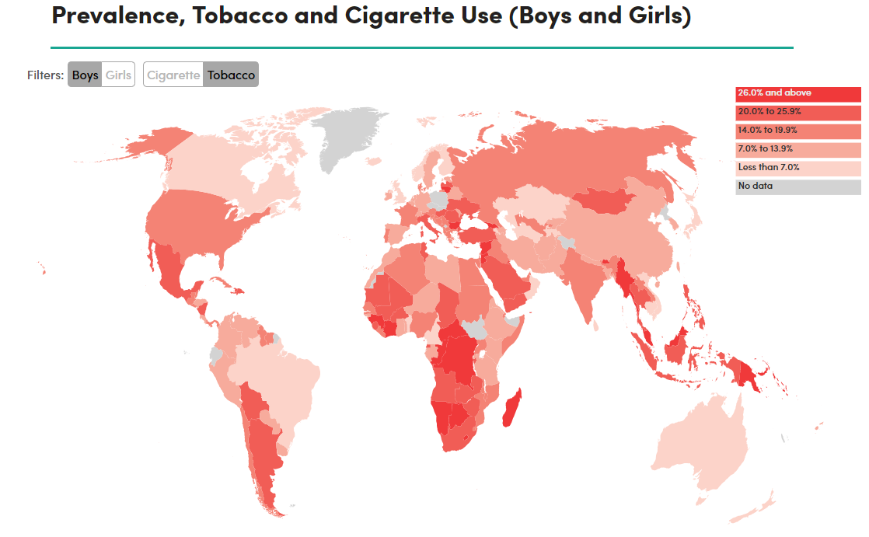
(Tobaccoatlas.org, 2019)
Notes:
The map displays data of Tobacco use by adolescent boys across the globe. The trainer should explain that the darker red indicated highest prevalence.

Slide 20
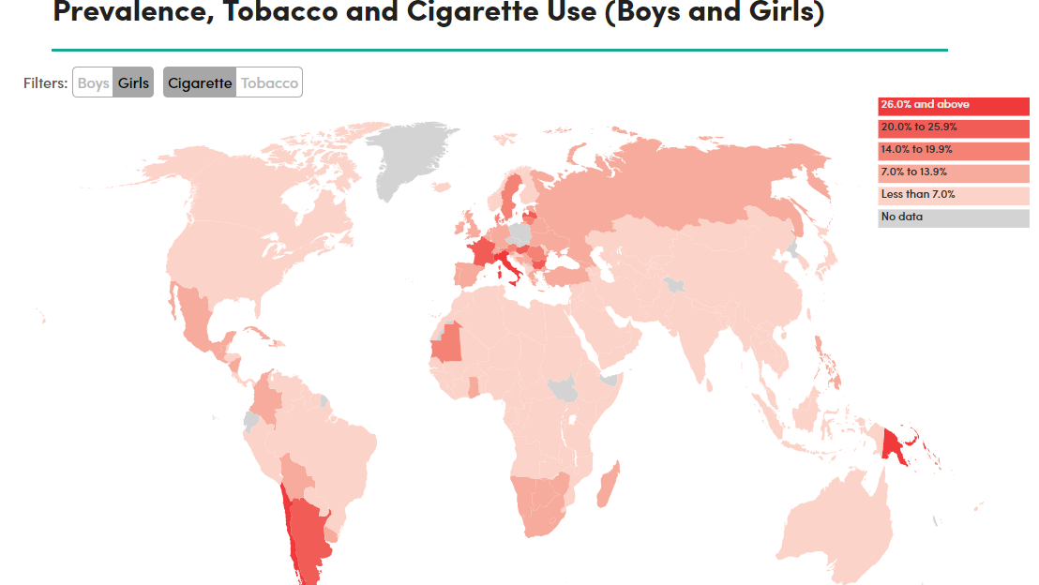
(Tobaccoatlas.org, 2019)
Notes:
The map displays data of cigarette use by adolescent girls across the globe. The trainer should explain that the darker red indicated highest prevalence.

Slide 21
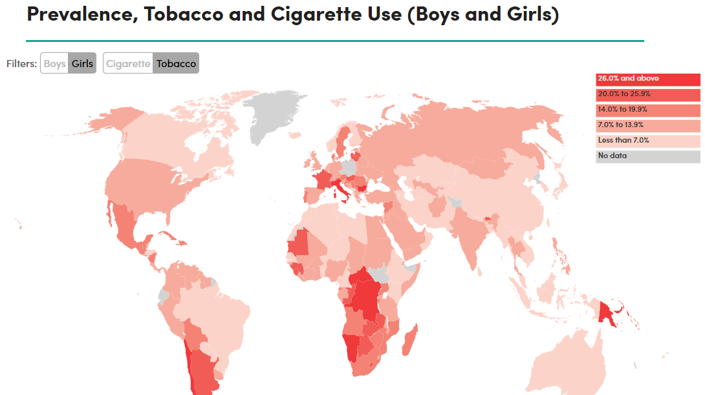
(Tobaccoatlas.org, 2019)
Notes:
The map displays data of Tobacco use by adolescent girls across the globe. The trainer should explain that the darker red indicated highest prevalence.

Slide 22
PREVALENCE BY REGION: ALCOHOL
Notes:
The trainer will introduce the prevalence of Alcohol by region as per the World Health Organization (WHO) and the Department of Health and Human Services (hhs.gov). These surveys are conducted in all regions; African, Middle Eastern, The Americas, Europe and South East Asia.

Slide 23
WHO, 2018
Notes:
The trainer will present the world map by the World Health Organization’s Alcohol status report in 2018. The trainer should clarify that the current data displays the current prevalence of alcohol consumption of people 15 and over.
The trainer should emphasize the numbers of the following data:
The European Region has the highest rate of all (43.8%)
The Region of the Americas has the second’s highest at (38.2%)
The Western Pacific Region (37.9%).
The Eastern Mediterranean Region has the lowest rates (1.2%)
Global trends:
Average alcohol consumption was highest in Europe, the Americas, and established market economies such as Australia, Japan, and New Zealand.
Average alcohol consumption generally was lower in Africa and Asia.
Alcohol consumption was particularly low in the Muslim countries in the eastern Mediterranean region and on the Indian subcontinent.

Slide 24
ALCOHOL IN ADOLESCENTS
Alcohol is the most used drug among adolescents, even more than Marihuana and Tobacco.
Adolescent males drink at a slightly higher rate than adolescent females.
Adolescents who drink alcohol are more likely to skip school, fail grades and become more aggressive in the future.
Adolescents who use alcohol are more likely to try other drugs.
Historically since 2002 to 2015 rates of underage drinking have remained stable.
(Alcohol.org, 2019; HHS, 2019;YRBSS, 2016)
Notes:
The trainer will discuss facts about alcohol in adolescents.
Alcohol is the most used drug among adolescents, even more than Marihuana and tobacco.
Adolescent males drink at a slightly higher rate than adolescent females.
Adolescents who drink alcohol are more likely to skip school, fail grades and become more aggressive in the future.
Adolescents who use alcohol are more likely to try other drugs.
Historically since 2002 to 2015 rates of underage drinking have remained stable.

Slide 25
ALCOHOL IN ADOLESCENTS GLOBALLY
Worldwide, more than a quarter (26.5%) of all 15–19-year-olds are current drinkers, amounting to 155 million adolescents:
Region | Adolescents (15-19) in millions
African Region | 22.5
The Americas | 29.9
Mediterranean Region | .7
South-East Asia Region | 37.9
Western Pacific Region | 41.9
(WHO, 2018)
Notes:
The trainer will discuss the current number of adolescent users across the globe. The trainer should point out this data is measured by numbers in millions per region.

Slide 26
Notes:
The trainer will discuss the data and assist the audience interpret the numbers. More importantly, the trainer should point out that most adolescents do not use alcohol and/or experiment with alcohol but are not current drinkers.
Acronyms for regions:
AFR = African Region, 21.4% are current drinkers.
AMR = The Americas Region, 38.2% are current drinkers.
EMR = Middle Eastern Region, 1.2% are current drinkers.
EUR = European Region, 43.8% are current drinkers.
SEAR = South-East Asian Region, 21.1% are current drinkers.
WPR = Western Pacific Region, 37.9 % are current drinkers.
World = 26.5% are current drinkers.

Slide 27
Notes:
The trainer should point out the difference between adult drinkers and adolescent drinkers across regions. It is important to point out that the rate of percentage of adolescents comes from the overall number of drinkers. For example; in the Americas Region 35.0 percent of all males 15+ includes all adults as well, but from that number there are 30.1% of adolescents, therefore there are more adult drinkers in general than adolescents. The data must not be interpreted in a way that can mistake the perception of the rate of alcohol use among adolescents.

Slide 28
ADOLECENT BINGE DRINKING
Binge drinking is the most harmful way adolescents use alcohol.
From those who drink, 18% binge drank alcohol.
Young males are more likely to engage in binge drinking.
Violence behavior such as; motor vehicle accidents, homicide and suicide can result from binge drinking.
(NIAAA, 2004)
Notes:
The trainer will discus the topic of binge drinking as it is one of the most harmful and most common ways young adolescents use alcohol.
Binge drinking is the most common way that adolescents use alcohol: Binge drinking is defined, for males, as drinking five or more drinks on one occasion, and, for females, four or more drinks on one occasion.
Binge drinking is the most harmful way adolescents use alcohol.
From those who drink, 18% binge drank alcohol.
Young males are more likely to engage in binge drinking.
Violence behavior such as; motor vehicle accidents, homicide and suicide can result from binge drinking.

Slide 29
PREVALENCE BY REGION: MARIHUANA
Notes:
The trainer will introduce the prevalence of Marihuana and facts about adolescent use of Marihuana.

Slide 30
(UNODC, 2018)
Notes:
The trainer will introduce the global prevalence of Marihuana or Cannabis use among young people by the UNODC.
Cannabis use among young people In most countries, cannabis is the most widely used drug, both among the general population and among young people. A global estimate, produced for the first time by UNODC, based on available data from 130 countries, suggests that, in 2016, 13.8 million young people (mostly students) aged 15–16 years, equivalent to 5.6 per cent of the population in that age range, used cannabis at least once in the previous 12 months.

Slide 31
MARIHUANA (CANNABIS)
Cannabis use can have a negative impact in the adolescent brain, resulting in irreversible neurological damage.
Cannabis use among adolescents has increased overtime as it can be viewed as a socially accepted behavior in many countries globally.
Cannabis is the preferred drug of choice among young people. It is often consumed along with other substances.
Social norms in some countries have created a cultural acceptance of Marihuana use.
Early onset is a predictor of chronic substance use among adolescents.
(OAS/CICAD, 2019; UNODC, 2018)
Notes:
The trainer can define what is Marihuana? Or can ask the group to provide their definition and understanding of the drug. Marijuana refers to the dried leaves, flowers, stems, and seeds from the hemp plant, Cannabis sativa. The plant contains the mind-altering chemical delta-9-tetrahydrocannabinol (THC) and other related compounds. Extracts can also be made from the cannabis plant.
Cannabis use can have a negative impact in the adolescent brain, resulting is irreversible neurological damage.
Cannabis use among adolescents has increased overtime as it can be viewed as a socially accepted behavior in many countries globally.
Cannabis is the preferred drug of choice among young people. It is often consumed along with other substances.
Social norms in some countries have created a cultural acceptance of Marihuana use.
Early onset is a predictor of chronic substance use among adolescents.

Slide 32
MARIHUANA CONTINUED
Smoking Marihuana can lead to breathing problems in the future.
Eating Marihuana can lead to poisoning.
Using marihuana in adolescence can damage the developing brain.
Research suggest that using marihuana before the age of 16 are at high risk of developing drug use disorders and mental health problems such as anxiety, depression, and personality disorders.
Adolescents experience lack of motivation, poor school performance and general dissatisfaction with life.
(NIDA, 2017; OAS/CICAD, 2019; UNODC, 2018)
Notes:
Smoking Marihuana can lead to breathing problems in the future.
Eating Marihuana can lead to poisoning.
Using marihuana in adolescence can damage the developing brain.
Research suggest that using marihuana before the age of 16 are at high risk of developing drug use disorders and mental health problems such as anxiety, depression, and personality disorders.
Adolescents experience lack of motivation, poor school performance and general dissatisfaction with life.
Brain development will be covered in more detail in the next module.

Slide 33
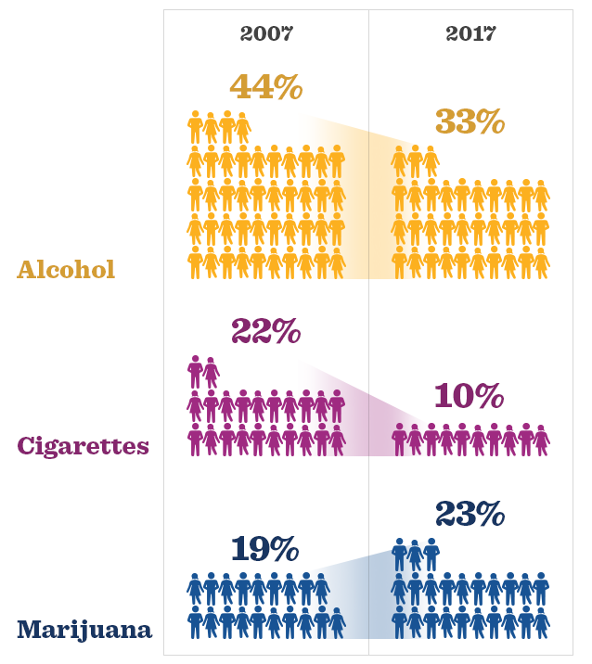
Trends in Alcohol, Cigarette and Marijuana Use: 30-day prevalence in 12th graders
(Johnston et al, 2018)
Notes:
The trainer should explain the data from the MONITORING FUTURE National Survey Results on Drug Use. The data show the prevalence of use in the last 30 days of alcohol, cigarettes and marijuana. The trainer should point out that Marijuana use among adolescents is increasing, whereas alcohol and cigarettes are decreasing in general.

Slide 34
OTHER SUSBTANCES
Notes:
The trainer will discuss other substances that even though they’re less frequent in adolescents, some of them are adolescent trends and on the rise of consumption.

Slide 35
INHALANTS
Definition of Inhalants
Volatile Solvents
Aerosol
Gasses
(CDC, 2019; SAMHSA, 2017)
Notes:
The trainer should provide an overview of the prevalence of inhalants use, as per the CICAD report on Drug Use in the Americas. The definition of inhalant is a challenge for drug researchers: the term covers a broad range of chemical substances used for different purposes and in most cases sold legally and have differing degrees of psychoactive and pharmacological effects. Prevalence of past year use of inhalants ranges from 1.4% to 12%. Inhalant use has been found at a young age, with lifetime prevalence rates of over 10% among eighth grade students in some countries.
Volatile Solvents: Liquids that vaporize in room temperature, available in homes; glues, correction fluids, markers, degreasers, dry-clean fluids, gasoline, etc.
Aerosol: Sprays; paint, deodorant, cooking spray, fabric protectors, etc.
Gasses: can be used in medical procedures (laughing gas) and available in homes such as; propane tanks, refrigerants.
Among young people living on the street, the most commonly used drugs are likely to be inhalants, which can include paint thinner, petrol, paint, correction fluid and glue.

Slide 36
ABOUT INHALANT USE
(CDC, 2019; SAMHSA, 2017)
Notes:
The trainer should discuss briefly the charts on the slide.
On this first chart, it should be noted that Felt-tip pens/markers or magic markers was the most commonly identified type of inhalant used by adolescents to get high.
The second chart displays the fact that females are higher users of inhalants than males.
Inhalants are highly accessible, cheap, and easy to hide; they are also addictive and deadly. Inhalants are particularly appealing to adolescents for many reasons; they are legal, low cost, and easy to acquire.

Slide 37
COCAINE & ECSTASY
Cocaine
Indicators of cocaine use vary by population, past year prevalence ranges from 0.03% to almost 2%.
There are clear differences in cocaine use among boys and girls in secondary school, with higher rates of use among boys.
Ecstasy
“Ecstasy” use in the general population ranges from 0.01% to a maximum of 0.9%.
“Ecstasy” use tends to be higher among boys than girls—except for Guatemala, Panama, and Uruguay, where they are roughly equal.
Club drugs such as “ecstasy”, methamphetamine, cocaine, ketamine, LSD and GHB are used in high-income countries
(OAS/CICAD, 2019; UNODC, 2018)
Notes:
Cocaine
Indicators of cocaine use vary by population, past year prevalence ranges from 0.03% to almost 2%.
There are clear differences in cocaine use among boys and girls in secondary school, with higher rates of use among boys.
Ecstasy
“Ecstasy” use in the general population ranges from 0.01% to a maximum of 0.9%.
“Ecstasy” use tends to be higher among boys than girls—except for Guatemala, Panama, and Uruguay, where they are roughly equal.
Club drugs such as “ecstasy”, methamphetamine, cocaine, ketamine, LSD and GHB are used in high-income countries

Slide 38
OPIOIDS & PRESCRIPTION DRUGS
Opioid use has increased over time.
Heroin is an opioid and the only illegal drug across the world.
Prescribed opioids include; oxycodone (OxyContin®), hydrocodone (Vicodin®), codeine, and morphine, among others.
In 2016, 3.6 percent of adolescents ages 12-17 reported misusing opioids over the past year.
Females are more likely to misuse prescription opioids.
Youth Opioid use is directly linked to sexual risk behavior.
(HHS, 2019; Hudgings et al, 2019)
Notes:
Cocaine
Indicators of cocaine use vary by population, past year prevalence ranges from 0.03% to almost 2%.
There are clear differences in cocaine use among boys and girls in secondary school, with higher rates of use among boys.
Ecstasy
“Ecstasy” use in the general population ranges from 0.01% to a maximum of 0.9%.
“Ecstasy” use tends to be higher among boys than girls—except for Guatemala, Panama, and Uruguay, where they are roughly equal.
Club drugs such as “ecstasy”, methamphetamine, cocaine, ketamine, LSD and GHB are used in high-income countries
Youth Opioid use is directly linked to sexual risk behavior.

Slide 39
OTHER TRENDS
Bath Salts
“Bath salts” are usually swallowed, snorted through the nose, inhaled, or injected with a needle. Snorting or injecting is the most harmful.
Bath salts can produce feelings of joy and increased social interaction, including an increased sex drive. But they can also cause paranoia, nervousness, and hallucinations (seeing or hearing things that are not real).
Researchers do know that bath salts are chemically like amphetamines, cocaine, and MDMA.
1% of adolescents has used bath salts.
Energy Drinks
High caffeine content per serving.
adolescent energy drink consumption has significantly increased in the past 10 years.
The CDC reports that drinkers aged 15 to 23 who mix alcohol with energy drinks are four times more likely to binge drink at high intensity (i.e., consume six or more drinks per binge episode) than drinkers who do not mix alcohol with energy drinks.
(CDC, 2018; NIDA, 2019; Ruiz & Scherr, 2018)
Notes:
Bath Salts
“Bath salts” are usually swallowed, snorted through the nose, inhaled, or injected with a needle. Snorting or injecting is the most harmful.
Bath salts can temporarily produce feelings of joy and increased social interaction, including an increased sex drive. But they can also cause paranoia, nervousness, and hallucinations (seeing or hearing things that are not real).
Researchers do know that bath salts are chemically like amphetamines, cocaine, and MDMA. Therefore, some of the effects of “bath salts"—such as feeling energetic and agitated—are similar.
Energy Drinks
High caffeine content per serving.
adolescent energy drink consumption has significantly increased in the past 10 years.
The CDC reports that drinkers aged 15 to 23 who mix alcohol with energy drinks are four times more likely to binge drink at high intensity (i.e., consume six or more drinks per binge episode) than drinkers who do not mix alcohol with energy drinks.

Slide 40
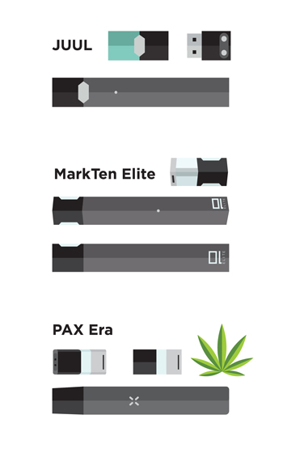
OTHER TRENDS
E-cigarettes
Contain nicotine a highly addictive substance
Trend that began with the introduction of e-cigarettes to help smokers quit cigarettes.
Adolescent use had increased throughout the past few years in developed countries.
A study found that user characteristics are mostly white male and female adolescents.
An average of 25% of students used e-cigarettes, which is correlated to use of other substances.
Data from the 2019 Monitoring the Future Survey of 8th, 10th and 12th graders show alarmingly high rates of e-cigarette use compared to just a year ago, with rates doubling in the past two years.
(CDC, 2020; Hrywna et al, 2020; NIDA, 2019)
Notes:
E-cigarettes
Contain nicotine a highly addictive substance
Trend that began with the introduction of e-cigarettes to help smokers quit cigarettes.
Adolescent use had increased throughout the past few years in developed countries.
A study found that user characteristics are mostly white male and female adolescents.
An average of 25% of students used e-cigarettes, which is correlated to use of other substances.
Data from the 2019 Monitoring the Future Survey of 8th, 10th and 12th graders show alarmingly high rates of e-cigarette use compared to just a year ago, with rates doubling in the past two years.

Slide 41
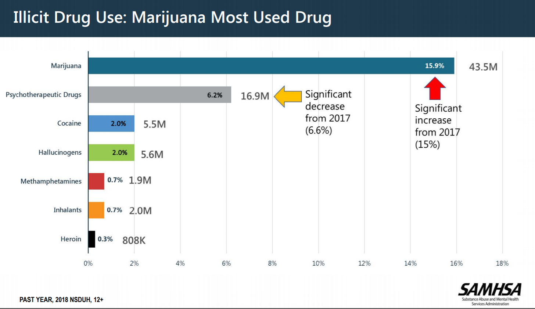
(SAMHSA, 2018)
Notes:
The trainer should discuss the graph and emphasize that Marihuana is the most used illicit drug among adolescents. The graph above represents data from a national survey in the United States.

Slide 42
ROUTES OF DRUG ADMINISTRATION
Oral – swallowed
Sublingually –Placed under tongue
Buccally – Placed between cheek/gums
IV – Given by injection into vein
Rectal –Placed into rectum
Ocular route- Placed in the eye
Nasally -Sprayed into the nose
Inhalation –Inhaling vapors by mouth and/or nose into lungs
Applied to the skin
Notes:
The trainer will discuss the general routes of drug administration. These are routes used by different types of substances, the trainer should ask the group if they’re aware of other ways of administering drugs into the body that are not mentioned in this list.
The trainer should discuss the following more in detail:
Oral:
The trainer should begin with the oral route. The drug gets into the blood by passing through the stomach to the small intestine where it is absorbed into the blood (like food or beverages). The drug must be absorbed into the blood, go to the heart, to the lungs, to the heart again, then to the brain. The drug is also diluted in with the food and beverages. This is a long and not very efficient way to take drugs. Drugs which are taken this way include alcohol, pills, marijuana or hashish.
IV:
The trainer should continue with injection. The drug goes directly into the bloodstream, through a subcutaneous injection (under the skin), an intramuscular injection (skin popping) or an intravenous injection (mainlining). The person gets the drug directly, with no gradual onset, so the user experiences what is called a "rush," which is the high all at once. Risks are related to unsanitary injection equipment, poor injection techniques, and toxins in the drugs. Poor injection techniques can produce damage to the nerves or abscesses. Bacteria injected can cause endocarditis, an infection around the lining of the heart. Heroin can be injected in any manner, cocaine can only be injected intravenously, due to its toxicity.
SMOKED:
The trainer should conclude with smoking or inhaling. The drug goes through the lung where air comes close to blood vessels for the exchange of oxygen and carbon dioxide. If stretched out, the surface area for this exchange inside the lungs would cover half a football field. The route is much shorter. as the blood only has to go from the lungs to the heart to the brain. This is the most efficient way to get your drug into your system. It also has a quick onset, with a "rush." Risks include damage to the lungs and frequent respiratory problems. Drugs taken this way include tobacco, crack/cocaine, marijuana and hashish.
Nasally:
The trainer should continue with sniffing. The drugs is passed through the mucous membranes, which are very thin and filled with blood vessels. These membranes are in the nose, gums and genitals. The drug passes through the membrane easily, gets into the blood, to the heart, lungs, then brain. This is a more efficient way to take drugs, although the risk is high for damage to these membranes. Drugs taken this way include tobacco, cocaine and heroin.

Slide 43
PREDISPOSITION TO SUBSTANCE USE/ABUSE
Notes:
The trainer will now discuss factors that place adolescents at risk of using substances

Slide 44
GENETICS
(Bevilacqua & Goldman, 2009)
Notes:
The trainer will discuss the role of genetic predisposition to addiction.
In this chart, it is depicted that Heritability (weighted mean and range) of 10 addictive disorders: dependence on or abuse of hallucinogens, stimulants, cannabis, sedatives, opiates, and cocaine; alcohol dependence; smoking persistence; caffeine consumption or heavy use; and pathological gambling. Weighted heritability means were computed using data from large national surveys of adult twins.
The literature suggest that genes influence a person’s predisposition to be addicted to specific drugs. However, the environment also plays an important role in a person’s exposure to the substance and also the person’s decision to try the substance.

Slide 45
Predisposition due to Mental Health vulnerabilities
Learning Disorders (ADD/ADHD)
Mental Illness
Childhood Trauma
(APA, 2001; NIDA, 2018; NCTSN, 2008)
Notes:
The trainer will discuss the predisposition to substance abuse due to mental health vulnerabilities.
Learning disorders: Children with learning disorders often experience difficulties in social environments which can lead to reduced self-esteem, academic difficulty, loneliness, depression and the desire for social acceptance. Thus, learning disabilities may indirectly lead to substance abuse by generating the types of behavior that typically lead to substance abuse.
Mental Illness: Research suggest high rates of comorbid substance use disorders and anxiety disorders—which include generalized anxiety disorder, panic disorder, and post-traumatic stress disorders. Adolescence is a crucial time where mental illness/symptoms can begin to appear, thus making this time-frame a vulnerable time for substance use.
Childhood Trauma: It is well-documented in research that one in four children and adolescents have experienced at least one traumatic event before the age of 16. From that number, about 13% will develop post-traumatic stress disorder (PTSD), which highly influences an adolescents’ vulnerability to substance use. This will be covered more in detail in the Trauma module.

Slide 46
GENERAL RISK/PROTECTIVE FACTORS
Child’s attachment style
Household Environment
Early onset
Self-esteem
Academic performance
Peers & social norms
Community
Poverty
(CDC, 2019; DHHS, 2011; Maharaj et al, 2009; NIDA, 2003)
Notes:
The trainer should explain that, as part of this training, some of the risk and protective factors which impact on these levels of use will be examined. The trainer will discuss risk and protective factors side by side as displayed in the definitions below.
Child’s attachment style (NIDA, 2003): this aspect refers to a child’s bonding with caregivers. A child who experiences warmth, support, feelings of care, being understood and love highly influences general wellbeing and decreases the risk of an adolescent making the choice to use. On the other hand, when a child experiences parental negative criticism, high expectations, rigid and strict parenting and emotional unavailability increases an adolescent’s risk for substance use.
Household environment (CDC, 2019): family history of substance use and current parental use of substances can highly impact an adolescents’ access and normality of substance use. An adolescent exposed to substances within the family unit has a higher risk of starting drug use. At the general population level, international research has identified extreme economic deprivation, conflict in the family, a family history of mental health/behavioral problems and a lack of a protective environment as common risk factors for most adolescent substance abuse, delinquency, pregnancy and dropping out of school.
Early Onset/use: research shows that young people who initiate drug use before the age of 15 are at twice the risk of having drug problems as those who wait until after the age of 19.
Self-esteem: Adolescents with a positive self-concept, high self-esteem and emotional wellbeing are less likely to use substances.
Academic Performance: The trainer should explain that, among the domains of factors which impact on adolescent substance use is included the school environment. Research has shown that low school quality, difficult access, labor demands and social norms are directly tied to the risk of substance use. Additionally, an adolescent’s positive connection/relationship with school can be a protective factor.
Peers & Social Norms: Adolescents find meaning in peer relationships as they’re figuring themselves out. Adolescents who associate with peers who are disruptive, use substances and are involved in criminal activity are more likely to use substances.
The trainer should explain that, on the broadest level, social norms, gender and region impact on adolescent substance use. The trainer should ask for specific examples, such as social norms which support alcohol use, double standards with respect to male vs female substance use, and regional accessibility to different substances.
Community: availability of drugs and other substances in the community can increase an adolescent’s access, therefore increasing substance use. High rates of delinquency in the community and general violence can also increase the risk.
Poverty: The trainer should explain that the family is a very important domain, as most adolescents are still living within a family environment. Household poverty and lack of connectedness increase risk of substance use. The trainer should ask participants why.
The trainer will close by summarizing these factors that influence substance use in adolescents and also let the group know that we will discuss more protective factors in detail in the treatment module where we will cover the concept of resilience. Ultimately, the goal of any program is to reduce risk factors and increase protective factors. Further, the international literature suggests that strategies incorporating positive youth development and resilience have a greater likelihood of improving the health outcomes of adolescent than risk-reduction alone

Slide 47
(UNODC, 2018)
Notes:
The trainer should explain the model in this slide and allow the audience to read the footnote to better understand the figure. These are the factors associated with risk of substance use.
Environmental factors were discussed in the previous slide. Developing resilience is one of the factors that best predicts overall wellness among adolescents. That is, when adolescents respond positively to adversity it is more likely that they will not engage in use of substances. Resilience is a major protective factor.
Genetic predisposition was discussed previously.
The combination of these factors can impact an adolescents’ likelihood of substance abuse in the future.

Slide 48
Summary
Adolescent substance abuse is a global public health problem where societies are tremendously affected.
International standards state that adolescents should not use substances as it can permanently damage the developing brain.
Alcohol and Marihuana are the most common drugs used among adolescents
A combination of genetics, environmental and social factors can impact adolescent substance use.
Notes:
Alcohol and marijuana are the main drugs of use by students in most of the countries included in this comparative report. Prevalence is relatively high for this population but there is plenty of variability from country to country. Tobacco is also used throughout the region, but to a lesser extent than alcohol and even marijuana. There is a lot of experimentation with cigarettes, but current use rates are very low. Marijuana prevalence overtook past year cigarette prevalence

