Slide 1
Trauma and Trauma Informed Care
Notes:
The trainer will introduce the topic of “trauma and trauma informed care”. The trainer will explain that we will discuss the concept of trauma, understand the nature of trauma and provide insight on how to assist youth who are struggling with addictions.

Slide 2
TRAUMA AND TRAUMA INFORMED CARE
Methodology:
Active discussion
Case Study
Role Play
Required Materials:
Easel Pad
Participant Manual
Notepad for each participant
Pens & Pencils
Duration: 6 hours
Notes:
The trainer will point out the methodology for this training. Active discussion refers to the trainer’s lecture but also participation from the audience in the form of questions, comments, suggestions that will enhance mutual learning.
The required materials for this module provide preparation for exercises.
The expected duration of this module is six hours.

Slide 3
TRAUMA AND TRAUMA INFORMED CARE
Learning Objectives
To define and conceptualize the nature of trauma.
To learn about the Adverse Childhood Experiences (ACE) Study.
To understand the neurological response to trauma.
To understand the link between trauma and addictions.
Notes:
The trainer will introduce the learning objectives. But first, the trainer can ask the audience what their expectations are about this module.
Learning Objectives
To define and conceptualize the nature of trauma.
To learn about the Adverse Childhood Experiences (ACE) Study.
To understand the neurological response to trauma.
To understand the link between trauma and addictions

Slide 4
TRAUMA AND TRAUMA INFORMED CARE
Learning Objectives continued…
To conceptualize trauma informed care approach.
To learn and practice trauma informed care skills when working with youth.
To integrate trauma informed care approaches within service institutions.
Notes:
The trainer will continue pointing out the learning objectives of this module.
Learning Objectives continued…
To conceptualize trauma informed care approach.
To learn and practice trauma informed care skills when working with youth.
To integrate trauma informed care approaches within service institutions.

Slide 5
OVERVIEW OF TRAUMA
Notes:
The trainer should introduce the concept of trauma, asking participants to brainstorm a list of events that they consider trauma. The trainer should make note of each on an easel pad. The list can include:
Domestic Violence
Sexual Assault
Racism
Sexism
Loss of a loved one
Homeless
Violent Crime—victim or witness
Natural Disaster
Language Barrier/moving to a different country
Abandonment
Physical Illness
Incarceration
The trainer should discuss that teenagers could be impacted from events that traditionally are not considered traumatic, for example:
Moving to a new place
Breaking up with a significant other as a teenager
Starting a new school

Slide 6
PROCESSING…
What did you notice about the group’s answers?
Unique interpretation of event(s)
Doesn’t have to happen to you
Notes:
The trainer should stress that trauma is subjective, and that there are major and minor traumas, in other words, trauma with a big T vs. little t. The experience is unique to the individual. Trauma can be simple, in other words a one time experience. It can also be complex, meaning a series of traumas over an extended period of time.

Slide 7
HIERARCHY OF TRAUMA
In small groups, examine the index cards given to you and decide how traumatic each event is using a scale of 1-20 (with 20 being the most severe and 1 being the least).
Tape the index card where you feel appropriate on the scale on the white board.
Notes:
Developing Hierarchy of Trauma
The trainer should draw on a white board or easel pad a scale from one to twenty, marking every five numbers on the board. S/he should divide participants into small groups, giving each group 3-5 cards, each with a different traumatic event on it. The trainer should ask the groups to come to a consensus on how “bad” each event is, 0 being harmless, 20 being very bad. Index cards include:
HIV Diagnosis
Surviving a hurricane
Child listening to parents fight
Verbal abuse by a stranger
Being held hostage
Being in a car accident
Witnessing a bad car accident where someone dies
Playing a violent video game
Going to war as a soldier
Repeated sexual assault as a child
Civilian in combat zone

Slide 8
DEFININING TRAUMA
Individual trauma results from an event, series of events, or set of circumstances experienced by an individual as physically or emotionally harmful or life-threatening with lasting adverse effects on the individual’s functioning and mental, physical, social, emotional, or spiritual well-being.
(SAMHSA, 2020)
Notes:
The trainer will introduce the definition of trauma which could affect adolescents and families.
Definition as per Substance Abuse Mental Health Services Administration (SAMHSA): Individual trauma results from an event, series of events, or set of circumstances experienced by an individual as physically or emotionally harmful or life-threatening with lasting adverse effects on the individual’s functioning and mental, physical, social, emotional, or spiritual well-being.

Slide 9
GENDER DIFFERENCES
Male
More likely to experience a potential traumatic event
More likely to report physical violence by strangers
More likely to experience trauma in childhood
Female
Two times more likely to be diagnosed with PTSD
More likely to report interpersonal physical or sexual abuse
More likely to experience more severe potential traumatic events
Likely to experience trauma from at any time from childhood throughout adulthood
(Tolin & Foa, 2006)
Notes:
The trainer will explain that there are similarities and differences between genders with respect to trauma. While both experience high levels of trauma, among males, the trauma will more likely be related to physical violence by strangers than among females, who are more likely to report interpersonal physical or sexual abuse, specifically a higher risk of adult sexual assault and child sexual abuse. Compared with male participants, female participants are more likely to experience certain types of PTE that are disproportionately likely to lead to PTSD. However, when male and female participants experienced the same category of traumatic event, there is a small to moderate effect indicating greater frequency or severity of PTSD among female participants compared with male participants.

Slide 10
ADVERSE CHILDHOOD EXPERIENCES (ACE) STUDY
(CDC, 2019; SAMHSA, 2020)
Notes:
The trainer should explain that there have been ongoing studies on the impact of childhood trauma on later life experiences. Childhood abuse, neglect, and exposure to other traumatic stressors which we term Adverse Childhood Experiences (ACE) are common.

Slide 11
ACE STUDY
About the Survey:
Measured three main areas related to childhood trauma.
Abuse, Neglect and Household Dysfunction
Self-awareness exercise
See appendix resource to find the ACE Survey
(CDC, 2019; SAMHSA, 2020)
Notes:
The trainer will discuss the ACE survey and the three main areas related to childhood trauma.
ABUSE: Physical, Emotional and Sexual.
NEGLECT: Physical, Emotional
HOUSEHOLD DYSFUNCTION: Mental Illness, Incarcerated Relative, Mother Treated Violently, Substance Abuse and Divorce.
SELF AWARENESS EXERCISE: Now the trainer will conduct a self-awareness exercise for the group. Direct the group to find the ACE survey on the appendix page and give the group about 5 minutes to complete the survey on themselves. The purpose of this activity is for providers to be aware of their scores, but they do not have to share to the group. The trainer should explain that it is important to be aware of our own vulnerabilities in conceptualizing and treating trauma in others.
ACE SURVEY
1. Did a parent or other adult in the household often or very often… Swear at you, insult you, put you down, or humiliate you? or Act in a way that made you afraid that you might be physically hurt? No___If Yes, enter 1 __
2. Did a parent or other adult in the household often or very often… Push, grab, slap, or throw something at you? or Ever hit you so hard that you had marks or were injured? No___If Yes, enter 1 __
3. Did an adult or person at least 5 years older than you ever… Touch or fondle you or have you touch their body in a sexual way? or Attempt or actually have oral, anal, or vaginal intercourse with you? No___If Yes, enter 1 __
4. Did you often or very often feel that … No one in your family loved you or thought you were important or special? or Your family didn’t look out for each other, feel close to each other, or support each other? No___If Yes, enter 1 __
5. Did you often or very often feel that … You didn’t have enough to eat, had to wear dirty clothes, and had no one to protect you? or Your parents were too drunk or high to take care of you or take you to the doctor if you needed it? No___If Yes, enter 1 __
6. Were your parents ever separated or divorced? No___If Yes, enter 1 __
7. Was your mother or stepmother: Often or very often pushed, grabbed, slapped, or had something thrown at her? or Sometimes, often, or very often kicked, bitten, hit with a fist, or hit with something hard? or Ever repeatedly hit over at least a few minutes or threatened with a gun or knife? No___If Yes, enter 1 __
8. Did you live with anyone who was a problem drinker or alcoholic, or who used street drugs? No___If Yes, enter 1 __
9. Was a household member depressed or mentally ill, or did a household member attempt suicide?
No___If Yes, enter 1 __
10. Did a household member go to prison? No___If Yes, enter 1 __
Once everyone completes the survey, the trainer will move onto the results of the ACE Study.

Slide 12
ACE STUDY RESULTS
The study found that:
childhood trauma was very common, even in employed white middle-class, college-educated people with great health insurance;
there was a direct link between childhood trauma and adult onset of chronic disease, as well as depression, suicide, being violent and a victim of violence;
more types of trauma increased the risk of health, social and emotional problems.
people usually experience more than one type of trauma – rarely is it only sex abuse or only verbal abuse.
(CDC, 2019; SAMHSA, 2020)
Notes:
The trainer will share the results of the ACE study by pointing out the findings.
The study found that:
childhood trauma was very common, even in employed white middle-class, college-educated people with great health insurance;
there was a direct link between childhood trauma and adult onset of chronic disease, as well as depression, suicide, being violent and a victim of violence;
more types of trauma increased the risk of health, social and emotional problems.
people usually experience more than one type of trauma – rarely is it only sex abuse or only verbal abuse.
The trainer will focus on the behavioral impact that is caused by childhood trauma related to substance abuse which will be covered on the next slide.

Slide 13
ACE RESULTS RELATED TO SUBSTANCE USE/ABUSE
Alcoholism and alcohol abuse
Chronic obstructive pulmonary disease
Depression
Fetal death
Health-related quality of life
Illicit drug use
Ischemic heart disease (IHD)
Liver disease
Risk for intimate partner violence
Multiple sexual partners
Sexually transmitted diseases (STDs)
Smoking
Suicide attempts
Unintended pregnancies
Early initiation of smoking
Early initiation of sexual activity
Adolescent pregnancy
Notes:
The trainer should go on to explain that ACE Study uses the ACE Score, which is a total count of the number of ACEs reported by respondents. The ACE Score is used to assess the total amount of stress during childhood and has demonstrated that as the number of ACE increase, the risk for the following health problems increases in a strong and graded fashion:
Alcoholism and alcohol abuse
Chronic obstructive pulmonary disease
Depression
Fetal death
Health-related quality of life
Illicit drug use
Ischemic heart disease (IHD)
Liver disease
Risk for intimate partner violence
Multiple sexual partners
Sexually transmitted diseases (STDs)
Smoking
Suicide attempts
Unintended pregnancies
Early initiation of smoking
Early initiation of sexual activity
Adolescent pregnancy

Slide 14
(CDC, 2019; SAMHSA, 2020)
Notes:
The trainer will reinforce the importance of the ACE as it relates to substance abuse. The trainer should stress that, although exact prevalence estimates vary, there is a consensus that most consumers of mental health services are trauma survivors and that their trauma experiences help shape their responses to outreach and services. As such, it is important to assume that every client seen in drug treatment is likely to have been exposed to trauma and therefore should be treated as such.

Slide 15
TRAUMATIC EXPEREINCES AROUND THE WORLD
Notes:
The trainer will discuss statistics about experiences of trauma around the world by the WHO World Mental Health Survey.

Slide 16
WORLD HEALTH ORGANIZATION WORLD MENTAL HEALTH SURVEY
The WHO World Mental Health Survey was conducted in the following regions of the world:
The Americas
South-East Asia
Europe
Africa
Eastern Mediterranean
The Western Pacific
(WHO, 2008)
Notes:
The trainer should introduce the WHO World Mental Health Survey.
The WHO World Mental Health Survey Initiative conducted The WHO World Mental Health Survey: Global Perspectives on the Epidemiology of Mental Disorders study. This is the largest global mental health study performed, with a sample of 200,000 individuals, which covered all regions of the world;
The Americas (Argentina, Brazil, Colombia, Colombia-Medellin, Mexico, Peru and the United States)
South-East Asia (Myanmar and Nepal)
Europe (Belgium, Bulgaria, France, Germany, Italy, Israel, Netherlands, Norther Ireland, Poland, Portugal, Romania, Spain, Spain-Murcia, Turkey and Ukraine)
Eastern Mediterranean (Iraq, Lebanon, Qatar, Saudi Arabia), and;
The Western Pacific (Australia, China 1 & 2, Japan and New Zealand)

Slide 17
WORLD HEALTH ORGANIZATION WORLD MENTAL HEALTH SURVEY FINDINGS
70.3% prevalence of lifetime traumatic experience exposure.
On average, participants reported at least 4.5 traumatic experiences.
Of the traumatic experiences reported:
27.1% were community violence-related
25% were accidents & illnesses
20.4% were related to organized violence
14.7% included rape and domestic violence
8.4% included physical violence by a caregiver as a child or witnessing domestic abuse.
(WHO, 2008)
Notes:
The study assessed lifetime exposure to traumatic experiences in adults. The results are shocking:
There was a 70.3% prevalence of lifetime traumatic experience exposure.
Of those the mean number of traumatic experiences was 4.5.
27.1% of traumatic experiences included being mugged/threatened with a weapon, other manmade disaster, and unexpected death of a loved one.
25% of traumatic experiences included accidents/injuries; natural disasters, toxic chemical spill, motor vehicle collision, any other life-threatening accident, life-threatening illness and loved one with a life-threatening illness.
20.4% of all traumatic experiences included participation in organized violence; combat experience as soldier, purposely injured/killed, accidentally injured/killed, witnessed death/serious bodily injury, and witness atrocities.
14.7% of all traumatic experiences included sexual violence victimization; rape, sexual assault, stalked, beaten by a romantic partner, traumatic event to loved one, and private event.
8.4% of all traumatic experiences included physical violence victimization; beaten by caregiver, beaten by anyone in the home (excluding romantic partner) and witnessed physical violence at home.

Slide 18
TRAUMA & THE BRAIN
Notes:
The trainer will introduce the neurological response to trauma.
The trainer should review how responses might differ in a traumatic event. Perception is personal. The trainer should ask what kind of factors might influence perception. S/he should also ask how those factors might impact on the trauma response. For example, an individual with a strong support system and caring adults would not be impacted in the same way as an individual who is homeless and alone on the streets. S/he should ask for more examples, which reflect the impact of stress management skills, coping skills, previous exposure to trauma, etc.
The trainer should ask how this understanding might affect the way one works with those affected by trauma? The context in which the trauma occurs in key, as well as those individual factors. As such, the immediate trauma response may vary, even when the people have experienced the same trauma.
What is important in the provision of services to individuals affected by trauma is an awareness of one’s own responses and feelings. In this manner, a hierarchy of trauma becomes unimportant, as the use of a hierarchy can cause some service providers to minimize what they perceive as minor incidents, without taking into account the subjective experience of the adolescent. Everyone is entitled to his/her own interpretation and will react differently. If the client is minimizing his/her reaction, it might be a coping mechanism and that’s acceptable.

Slide 19
THE EMOTIONAL BRAIN
Important brain structures:
The Amygdala
Prefrontal Cortex
Notes:
The amygdala, which readies the body for action, may get "hi-jacked" by neurobiological changes caused by trauma, and the trauma victim responds before the "thinking" part of the brain (i.e., cerebral cortex) can weigh threats. The resultant hypervigilance seen in trauma victims can cause them to go immediately from stimulus to an arousal response, without being able to make the intervening assessment of the cause of their arousal. This causes them to overreact and intimidate others.
The amygdala is a small, almond-shaped portion of the brain. It’s the emotional part. It’s the primitive part of the brain. It interprets messages that there’s danger or it’s safe. It knows nothing about reasoning or cognitive functions. It deals with feelings and emotions. It’s the alarm portion of the brain.
It becomes highly active during and while remembering a traumatic incident. It controls our behavior. When you’ve experienced trauma it’s hypersensitive--overreacts to normal stimuli.
Trauma affects many other parts of the brain as well. De Bellis and colleagues noted that pediatric subjects with PTSD had smaller intracranial, cerebral, prefrontal cortex, prefrontal cortical white matter, right temporal lobe volumes, and areas of the corpus callosum and its subregions.
Because of the excess and adverse neurobiological results of trauma, people with PTSD may experience a deactivation of the prefrontal cortex (which is responsible for executive functioning.)
The prefrontal cortex, the part of the frontal lobes lying just behind the forehead, is often referred to as the “CEO of the brain.” This brain region is responsible for cognitive analysis and abstract thought, and the moderation of “correct” behavior in social situations. The prefrontal cortex takes in information from all of the senses and orchestrates thoughts and actions to achieve specific goals.
The prefrontal cortex is one of the last regions of the brain to reach maturation. This delay may help to explain why some adolescents act the way they do. The so-called “executive functions” of the human prefrontal cortex include:
Focusing attention
Organizing thoughts and problem solving
Foreseeing and weighing possible consequences of behavior
Considering the future and making predictions
Forming strategies and planning
Ability to balance short-term rewards with long term goals
Shifting/adjusting behavior when situations change
Impulse control and delaying gratification
Modulation of intense emotions
Inhibiting inappropriate behavior and initiating appropriate behavior
Simultaneously considering multiple streams of information when faced with complex and challenging information
**Traumatic experiences slow down the maturation of this area of the brain!!!!!!
If those areas of the brain are impacted by traumatic experiences, what is the influence on decision making ability, and how may drug use behaviors be related?

Slide 20
THE BRAIN’S REPOSNSE TO TRAUMA
Amygdala
Detects Situation of danger
Sympathetic Nervous System Activates
Stress hormones released
Bodily
reactions
Prolonged state of alarm
Notes:
The trainer will explain the pathway of the brain’s response to trauma.
The amygdala is like the “smoke detector”, responsible to respond to situations that are threatening. Sometimes the Amygdala might react with just a perceived threat. If someone suddenly entered the room, we are conducting this training without notice, most people would jump at the sound of a slammed door. That is the amygdala’s job. When someone experiences a traumatic event, the threat is real.
The Amygdala detects possible situations of danger, then the sympathetic envious system is activated and releases stress hormones. The outcome of this reaction is a prolonged state of alarm in the body and emotional brain.

Slide 21
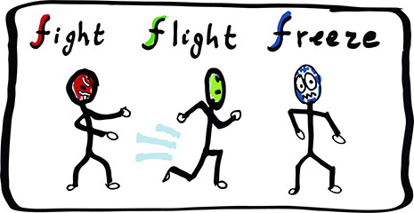
TRAUMA REACTIONS
Notes:
The trainer should ask the group if they have heard of the “Fight, Flight or Freeze” reaction, noting that the body prepares for any of these reactions when confronted with a threat. The trainer should ask what kind of the changes happen physically when threatened. These should include such reactions as dilated pupils, increased adrenaline, blood diverted to limbs, increased heart rate, etc.
The memory of the traumatic event can also be affected. The emotional brain is in charged of survival and in this type of state, the brain’s ability to encode memories in an organized manner fails to do so. This is why sometimes survivors of trauma will forget details of an event, or does not recall events (Campbell, 2019).
The trainer should ask the participants how do the fight, flight and freeze modes connect to drug using behaviors? The trainer should note that trauma may cause such reactions as aggression, running away from problems, feeling separate from one’s body and one’s experiences (depersonalization and dissociation). Participants may respond with some of the following:
Aggression/rage=looking for an outlet for release, such as drugs
Running away from problems =not recognizing the long term impact of actions
Depersonalization=feeling separate from your body, don’t feel like you own your actions, don’t care about risky behaviors
Dissociation=Leads to little recall—don’t learn from mistakes=more risk taking behaviors even if they know it is wrong
The trainer will explain that this overload of stress makes the patient more likely to experience other symptoms which we will now address…

Slide 22
TRAUMA & ADDICTIONS
Adolescents with as history of early trauma are more likely to be addicted to substances, and display the following:
Engage in risk-taking behaviors
Be more impulsive
Have boundary issues
Distrust others
Low self-esteem
Difficulty relating to others
Display irritability/hostility
Notes:
The trainer will explain that trauma and addictions are interrelated.
Adolescents with a history of early trauma engage in more risk-taking behaviors, such as substance abuse (including binge drinking), multiple sex partners, and criminal involvement, and are at a greater risk for sexual assaults and relationship violence; and add data about childhood trauma is common; "38.5% of American adults endorse having experienced a traumatic event before age 13 years”.

Slide 23
STRESS DISORDERS
Stress disorders are a cluster of diagnoses that differentiate different types of reactions individuals can experience resulting from trauma.
International Classification of Diseases (ICD) Definitions
Adjustment Disorder
Post-Traumatic Stress Disorder
Complex Post-Traumatic Stress Disorder
(ICD, 2020)
Notes:
The trainer will introduce usual stress disorder associated with experiencing trauma as per The International Classification of Diseases (ICD), which is an internationally accepted manual to code diseases. The trainer will discuss Adjustment Disorder, Post-Traumatic Stress Disorder, and Complex Post-Traumatic Stress Disorder in detail on the next slides.

Slide 24
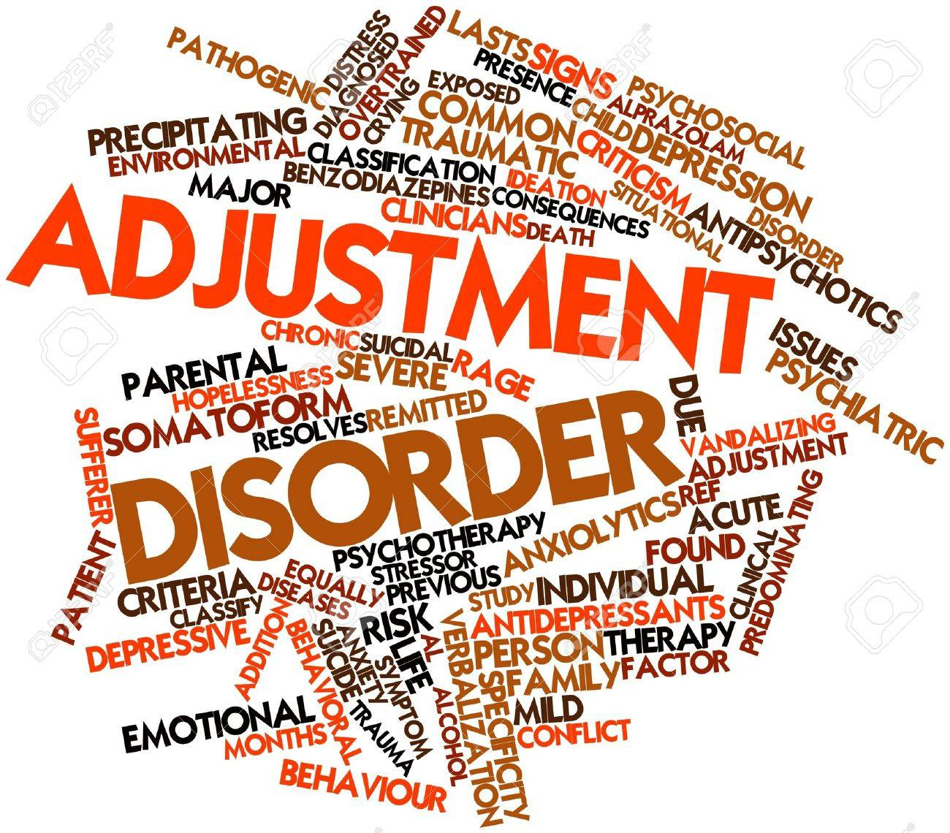
ADJUSTMENT DISORDER
(ICD, 2020)
Notes:
Adjustment Disorder Definition: Adjustment disorder is a maladaptive reaction to an identifiable psychosocial stressor or multiple stressors (e.g., divorce, illness or disability, socio-economic problems, conflicts at home or work) that usually emerges within a month of the stressor.
The disorder is characterized by preoccupation with the stressor or its consequences, including excessive worry, recurrent and distressing thoughts about the stressor, or constant rumination about its implications, as well as by failure to adapt to the stressor that causes significant impairment in personal, family, social, educational, occupational or other important areas of functioning. The symptoms are not of sufficient specificity or severity to justify the diagnosis of another Mental and Behavioural Disorder and typically resolve within 6 months, unless the stressor persists for a longer duration.

Slide 25
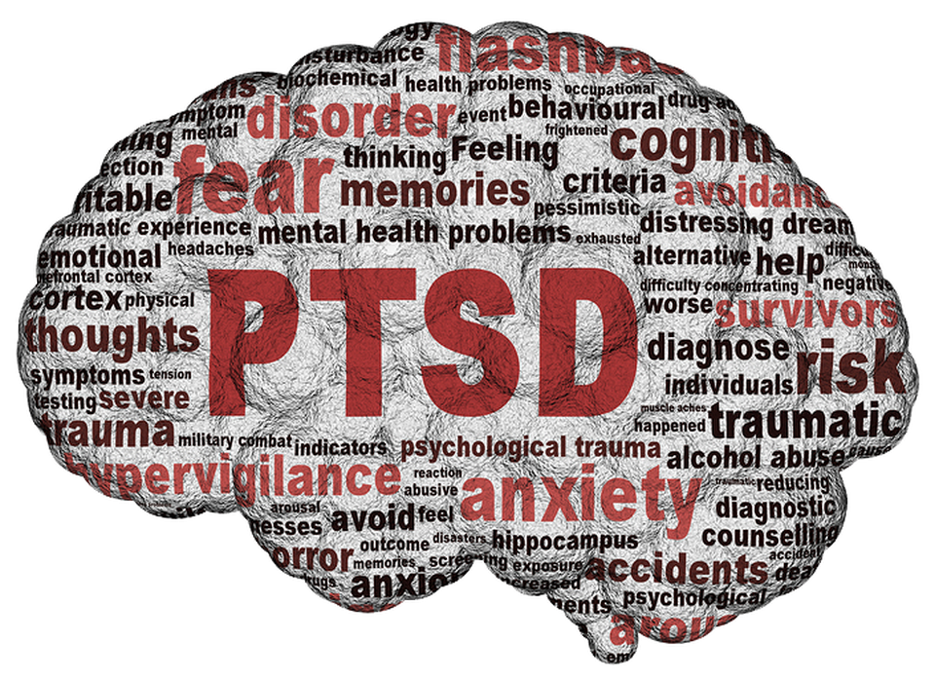
POST-TRAUMATIC STRESS DISORDER (PTSD)
Re-experiencing
Avoidance
Hypervigilance
Impairment in major life aspect
(ICD, 2020)
Notes:
Post-traumatic stress disorder (PTSD) Definition: Post-traumatic stress disorder (PTSD) is a disorder that may develop following exposure to an extremely threatening or horrific event or series of events. It is characterized by all of the following:
re-experiencing the traumatic event or events in the present in the form of vivid intrusive memories, flashbacks, or nightmares. These are typically accompanied by strong or overwhelming emotions, particularly fear or horror, and strong physical sensations;
avoidance of thoughts and memories of the event or events, or avoidance of activities, situations, or people reminiscent of the event or events; and
persistent perceptions of heightened current threat, for example as indicated by hypervigilance or an enhanced startle reaction to stimuli such as unexpected noises.
The symptoms persist for at least several weeks and cause significant impairment in personal, family, social, educational, occupational or other important areas of functioning.
The trainer will emphasize that Post-Traumatic Stress Disorder can be the result of an individual experiencing one or various experiences where the individual believes their life was at risk. This is different than Complex Post-Traumatic Stress Disorder which we will discuss on the next slide.

Slide 26
COMPLEX POST TRAUMATIC STRESS DISORDER (CPTSD)
All individuals with CPTSD meet criteria for PTSD as well.
Additional symptoms include:
Affect Regulation
Negative Self-concept
Interpersonal disturbances
(ICD, 2020)
Notes:
The trainer will build from the definition of PTSD and discuss the additional symptoms that are present in CPTSD. Individuals with CPTSD met all the criteria for PTSD as well. However, there are more symptoms in CPTSD; affect regulation, negative self-concept, and interpersonal disturbances.
Complex Post-Traumatic Stress Disorder Definition: Complex post-traumatic stress disorder (Complex PTSD) is a disorder that may develop following exposure to an event or series of events of an extremely threatening or horrific nature, most commonly prolonged or repetitive events from which escape is difficult or impossible (e.g., torture, slavery, genocide campaigns, prolonged domestic violence, repeated childhood sexual or physical abuse).
All diagnostic requirements for PTSD are met. In addition, Complex PTSD is characterized by severe and persistent
problems in affect regulation;
beliefs about oneself as diminished, defeated or worthless, accompanied by feelings of shame, guilt or failure related to the traumatic event; and
difficulties in sustaining relationships and in feeling close to others. These symptoms cause significant impairment in personal, family, social, educational, occupational or other important areas of functioning.

Slide 27
SYMPTOMS = ADAPTATIONS
Individuals react differently to trauma and may experience a range of physical and/or emotional reactions.
There is no “right” or “wrong” way to react to trauma.
Human responses are normal reactions to abnormal events.
Notes:
The trainer should stress, once again, that individual reactions to trauma are mediated by a number of factors, like the risk and protective factors just reviewed. As such, individuals react differently to trauma, even if the trauma experienced is the same. There is no “right” or “wrong” way to react to trauma, although there are healthier and more damaging reactions.

Slide 28
TRAUMA INFORMED CARE (TIC)

Slide 29
TRAUMA INFORMED CARE
A program, organization, or system that is trauma-informed:
Realizes the widespread impact of trauma and understands potential paths for recovery;
Recognizes the signs and symptoms of trauma in clients, families, staff, and others involved with the system;
Responds by fully integrating knowledge about trauma into policies, procedures, and practices; and
Seeks to actively resist re-traumatization
(SAMHSA, 2014)
Notes:
The trainer should then review the definition of “trauma-informed care,” as per the US Substance Abuse and Mental Health Services Administration (SAMHSA). That definition is as follows:
“A program, organization, or system that is trauma-informed:
Realizes the widespread impact of trauma and understands potential paths for recovery;
Recognizes the signs and symptoms of trauma in clients, families, staff, and others involved with the system;
Responds by fully integrating knowledge about trauma into policies, procedures, and practices; and
Seeks to actively resist re-traumatization”

Slide 30
TRAUMA INFORMED CARE
A culture change
A multidimensional, systems approach to dealing with histories of trauma
Taking steps to make sure every part of the organization, management, and service delivery system is assessed and potentially modified to include a basic understanding of how trauma affects the life of an individual seeking services
(SAMHSA, 2014)
Notes:
The trainer should stress that trauma has a long-term impact on individuals. For example, most people tend to think linearly normally and look for consistency – trauma survivors cannot focus, recall, think differently. The trainer should explain that, in drug treatment, we tend to label these kind of clients as “non-compliant,” as they are not responding to our screenings and assessments, as well as our interventions in the manner that is normally expected. However, due to the recognition of the high prevalence of trauma, it is necessary that, particularly in drug treatment, there is a culture change to respond to this recognition. It cannot be an individual within an organization, but the organization as a whole must respond in order to take steps to make sure every part of the organization, management, and service delivery system is assessed and potentially modified to include a basic understanding of how trauma affects the life of an individual seeking services.

Slide 31
TRAUMA INFORMED CARE
TIC is a universal precautions approach that is designed to be both preventative and rehabilitative in nature. It address the relationship between environmental or subjective triggers, the perception of danger, and the neurobiological activation that leads to a distressed physical state and resulting in problematic behavior.
(Harris & Fallot, 2001; NASMHPD, 2010 )
Notes:
The trainer should stress that trauma-informed organizations utilize universal precautions, asking participants what they think that means. S/he should explain that universal precautions assume that you’re dealing with a trauma survivor. As such, interventions across the organization are designed to empower and support, to avoid re-traumatization. The trainer should provide this example: When a doctor has to perform surgery on someone with physical trauma, he/she puts on gloves to operate. Think about trauma informed care as the gloves that you need to put on to be able to effectively work with the survivor.

Slide 32
Key Concept: Trauma-informed Care
Safety
Trustworthiness
Peer Support
Collaboration
Empowerment, Voice, Choice
Cultural, Historical and Gender Issues
(SAMHSA, 2014)
Notes:
The trainer will discuss the core concepts of trauma-informed care and provide examples from each concept:
Safety: the physical and emotional space of a treatment center, clinic, or NGO is safe; from appropriate room spaces decorated with developmentally-appropriate items to rooms that are private. Emotional safety refers to staff being able to get along well to work together for the youth. Youth can tell of two co-workers don’t like each other or if there’s gossip or other dysfunction in the workplace. For youth to feel safe, they have to feel it in the treatment center.
Trustworthiness: The organization is transparent with operations and decisions to be able to build trust with the youth. This means that staff are responsible to explain the processes and be honest about the possible outcomes. When organizations are open and trustworthy, youth engagement is higher.
Peer Support: Mutual connection, support and shared experiences to build trust with youth.
Collaboration: Partnering with the youth towards the same goals to increase engagement. Youth that are treated as partners in their healing are more likely to own their recovery. Therefore coming up with goals that both provider and youth agree with is critical.
Empowerment, Voice, Choice: It is critical that youth feel their voice matters. Organizations aim to ensure practices that encourage youth to decide, provide feedback, and chose how they want to work on their healing.
Cultural, Historical and Gender Issues: The organization does not discriminate based on race, ethnicity, sexual orientation, nationality, disability, etc..
The trainer will discuss cultural diversity in detail on the next slide.

Slide 33
Diversity is complex and varies across countries
Let’s do an exercise!
Notes:
The trainer will introduce the ADDRESSING Model by Pamela Hayes. The trainer will point out the complexity of the concept of diversity. The model provides with examples of cultural characteristics: Age, Developmental disability, Disability acquired later in life, Religion and spiritual orientation, Ethnicity/Race identity, Sexual Orientation, Indigenous heritage, National Origin, and Gender. The trainer will discuss the groups with power and less power as they are displayed on the slide. The trainer should also explain that this specific chart is based on the U.S. and Canadian context, but other country’s information can be very different. For example; countries where most citizens are Muslim, that will be the religion under “power” and other religions are in the “less power” Colum.
The trainer will facilitate a cultural awareness exercise. First participants will become familiar with the ADDRESSING Model’s cultural characteristics. Participants are instructed to pair with a peer and for about 2 minutes for each person, they will share with the other person an aspect of their identity from the model and discuss the impact of that identity on their lives. For example; a participant might choose a religion and discuss how it shapes their worldview and way of coping with stress. After each person shares, the trainer will bring the group together and then ask the group: “Is there something new you learned from your partner’s experience?”, “

Slide 34
EXAMPLES OF TRAUMA INFORMED LANGUAGE
NOT TRAUMA INFORMED | TRAUMA INFORMED
“Youth is resistant to treatment” | “Youth is struggling to cope with abstinence”
“Youth is disrespectful to staff” | “Youth does not feel safe in the space”
“Youth lies about the use of substances” | “Youth is working through ambiguity of substance use”
“Youth is not engaged in treatment plan” | “Youth needs adaptation to treatment plan to meet them where they’re at”
“Youth plays the victim” | “Youth is letting me know their previous coping styles to being held accountable”
“The family is unwilling to heal” | “The family requires multiple interventions for their needs”

Slide 35
Smart Tips for Building and Utilizing a Trauma-Informed Lens in Your Task Force
Review agency policies and procedures to identify and remove any that are potentially unsafe and harmful to trafficking victims with histories of trauma.
Provide education and training of staff, including those working directly with trafficking victims as well as other providers in relevant systems of care.
Screen for trauma in multiple settings.
(Clawson, Salomon & Goldbatt, 2008)
Notes:
The trainer will discuss the suggested step to ensure a trauma informed lens in organizations.
Review agency policies and procedures to identify and remove any that are potentially unsafe and harmful to trafficking victims with histories of trauma.
Provide education and training of staff, including those working directly with trafficking victims as well as other providers in relevant systems of care.
Screen for trauma in multiple settings.

Slide 36
Ensure safety and meet basic service needs.
Build long-term, sustaining relationships and provide opportunities for regaining valued social roles.
Provide access to trauma-specific treatment services.
Specific to adolescents, use group therapy to address skills development, affect regulation, interpersonal connections, and competence and resiliency building.
Understand the role that culture plays in resiliency and the importance of community resources as potentially mediating the trauma experience, particularly for foreign-born victims.
(Clawson, Salomon & Goldbatt, 2008)

Slide 37
Make peer models and supports available.
Engage survivors in programming.
Develop alternatives to traditional therapies.
(Clawson, Salomon & Goldbatt, 2008)

